Slide 1
Adv. Machine Learning
BY
Adnan Amin

Slide 2
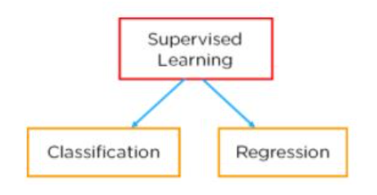
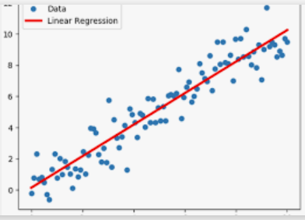
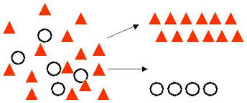
Supervised Learning
In Supervised Learning, the model learns by example.
Along with our input variable, we also give our model the corresponding correct labels.

Slide 3
Classification
Classification consists of assigning a class label to a set of unclassified cases.
Assigning an object to a certain class based on its similarity to previous examples of other objects.
Classification algorithms used in machine learning utilize input training data for the purpose of predicting the likelihood or probability that the data that follows will fall into one of the predetermined categories.
Examples:
Predict class label as safe or risky for loan data.
Yes or no for marketing data.
True or false for customer churn

Slide 4
Classification
Supervised Classification (Classification)
In which the class label of each training tuple is known.
Unsupervised Classification (Clustering)
In which the class label of each training tuple is unknown.
Set of possible classes is not known. After classification we can try to assign a name to that class. Unsupervised classification is called clustering. Ambiguaty

Slide 5
Classification
Classification is a two-step process:
The learning step
Where a classification model is constructed and provide training on the previous data.
Classification step
Where the model is used to predict class labels for new data.
A process of classification is performed through a classifier.
Classifier:
A model is constructed to predict or classify the class. This model is predictor similar to regression analysis in statistical methodology.

Slide 6
Basic understanding on classification
Slide ©Copyright
2
3
Training Set
Classifier
1
Learning Step
_{Dataset}
Classification Step
4
5
Validation
Test Set
Training Set: made up with known class labels.
Test set; contains samples with class unknown labels.
6
Answer

Slide 7
Basic Understanding cont.
Dataset:
A repository which contains some historical pattern related to domain/problem.
Training phase or Learning Step:
Where a classification algorithm builds the classifier by analyzing/learning from a training set.
Tells to classifier that each tuple is belongs to which class label.
The class label of each training tuple is provided, this step is also known as supervised learning.
Classification Phase:
Predict the associated class label of each given tuple.

Slide 8
How to provide training/learning to classifier
There are many well-known classification algorithms such as:
Tree Induction
Decision tree
Bayes classification
Bayesian classifiers
Naïve Bayesian classifier
Rule-based classification
Rough set theory
Part
Ridor
Ripper

Slide 9
Types of Classification
Binary Classification
refers to those classification tasks that have two class labels.
For example:
Email spam detection (spam or not).
Churn prediction (churn or not).
Conversion prediction (buy or not).
Multi-Class Classification
refers to those classification tasks that have more than two class labels.
For example:
Face classification.
Plant species classification.
Optical character recognition.

Slide 10
K-Nearest Neighbored
K-NN algorithm can be used for Regression as well as for Classification.
Non-parametric algorithm
cannot make any assumption on underlying data.
Lazy Learner algorithm
cannot learn from the training set it stores the dataset and at the time of classification it performs an action on data.

Slide 11
Eager vs Lazy Learning Algorithms
Eager
Construct a generalized model from a given dataset before performing prediction on given new points to classify.
Then ready/eager to classify unobserved data points.
Lazy
No need for learning or training of the model and all of the data points used at the time of prediction.
Do less work in the training phase and more work in the testing phase to make a classification.
Required time and memory.
Also known as instance-based learners, because learning is based on stored instances.
Curse of Dimensionality
Source. DataCamp.com

Slide 12
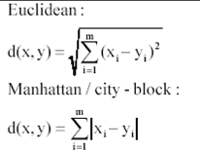
How does it work?
Step-1: Select the number K of the neighbors
Step-2: Calculate the Euclidean distance of K number of neighbors
Step-3: Take the K nearest neighbors as per the calculated Euclidean distance.
Step-4: Among these k neighbors, count the number of the data points in each category.
Step-5: Assign the new data points to that category for which the number of the neighbor is maximum.

Slide 13
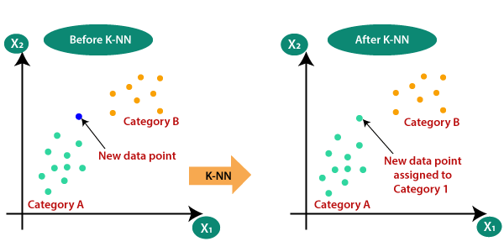
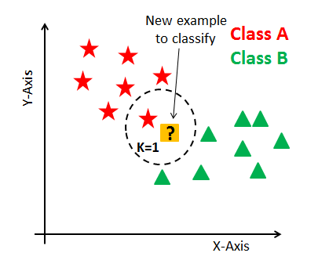
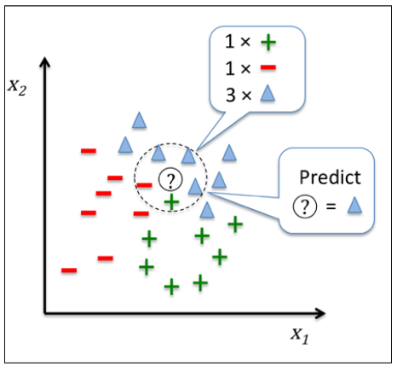
Visual Representation

Slide 14
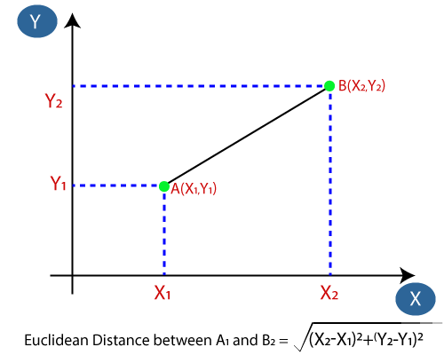
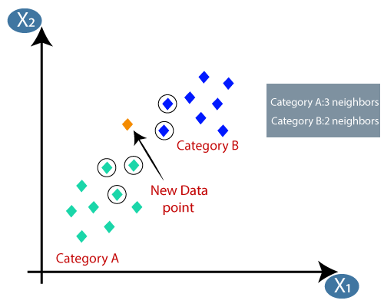
Based on Euclidean Distance Find Neighbors
The Euclidean distance is the distance between two points.

Slide 15
